Slide 1
WEBTECHNOLOGIES
INTRODUCTION TO NODE.JS
Systemtechnik 19/20

Slide 2
WHAT IS JAVASCRIPT?
Dynamically typed programming language
First version in 1995
Netscape Browser
Supports
Object-orienteded Programming
Functional Programming
Notes:
A type is associated with a value rather than an expression.

Slide 3
JAVASCRIPT ENGINES
Execute JavaScript code
Spider-Monkey (Firefox)
V8 (Chrome, Edge)
Translation to machine code
Former: Interpreter
Nowadays: JIT-Compiler
Notes:
JIT = Just In Time

Slide 4
WHAT IS NODE.JS?
JavaScript runtime
Execute JavaScript outside of a browser
Main components
V8 JavaScript-Engine
API
HTTP requests, file access, ...
Notes:
Node.js is no programming language and no framework
API = Application Programming Interface

Slide 5
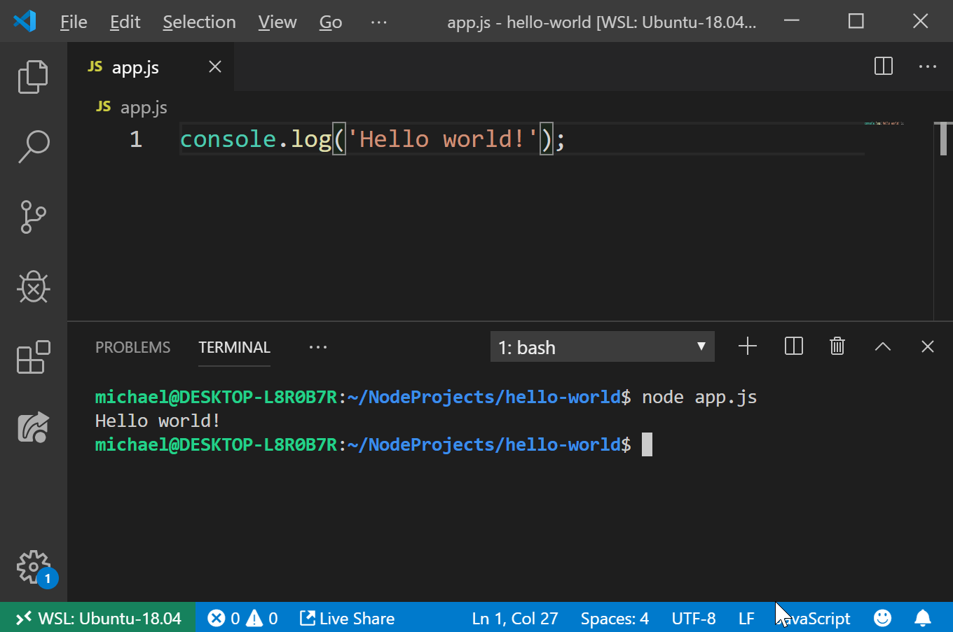
HELLO WORLD!

Slide 6
NODE.JS APPLICATIONS
Console applications
e.g. Angular CLI
Web applications
e.g. Netflix
Desktop applications
with Electron framework (Node.js + Chromium)
e.g. Visual Studio Code

Slide 7
NODE.JS FEATURES
Single-Threaded
Whole JavaScript-Application runs in one thread
Non-Blocking I/O
Thread isn‘t blocked e.g. during file access
Therefore Node.js is …
well suited for I/O-intensive applications
not well suited for CPU-intensive applications
Notes:
Child processes are possible (https://nodejs.org/api/child_process.html)

Slide 8
NODE.JS FEATURES
Fast
Written in C / C++
Uses Chrome V8
Full support of ES 2015 (ES 6)
Notes:
Child processes are possible (https://nodejs.org/api/child_process.html)

Slide 9
WHAT IS ES?
ECMAScript
Basis of JavaScript
Standardized by ECMA International
ES is constantly adjusted
New language features added
Yearly updates since 2015

Slide 10
NODE.JS INSTALLATION
On nodejs.org you find two versions
Long-term support (LTS)
Stable version for production applications
Current
Version with latest features
Notes:
LTS: critical bugs will be fixed for 30 months

